Slide 1
Data Structures Workshop
Day 15

Slide 2
Workshop Outline
Shell Sort
Heaps
Heap Sort
Round Robin (Queues)
Mid-Semester SEP Workshop Survey

Slide 3
Exam 2 Content
NOTE: Subject to change, but as for now…
More Recursion
Stacks
Infix & Postfix Notation
Queues
Priority Queues
Sorting Algorithms (Merge, Quick, Shell, Bucket, Heap)
Heaps
Hashing (Direct, Linear, Quadratic, Double, and Open Chaining)

Slide 4
More… Sorting Algorithms
im sorry

Slide 5
Shell Sort

Slide 6
What is Shell Sort?
The Shell sort algorithm in a sense, is a variation of Insertion sort.
Sometimes in Insertion Sort, in order to get an element in its correct sorted position, many shifts are required to do be done to do so. Shell sort aims to reduce these number of operations by comparing elements that are far apart first and gradually reducing the gap between elements to perform smaller, more frequent swaps.
In Shell sort, we use a gap value to make sublists (with the intervals between each value being the gap value).

Slide 7
There are many ways to determine a gap size, but for the sake of this class, we’ll just say:
Gap Value = SizeofArray/ 2
After the sort for each subarray occurs, we’ll then divide the gap value by 2. We’ll then repeat the sorting process (iterate) until the gap value is equal to 1, where normal insertion sort occurs.

Slide 8
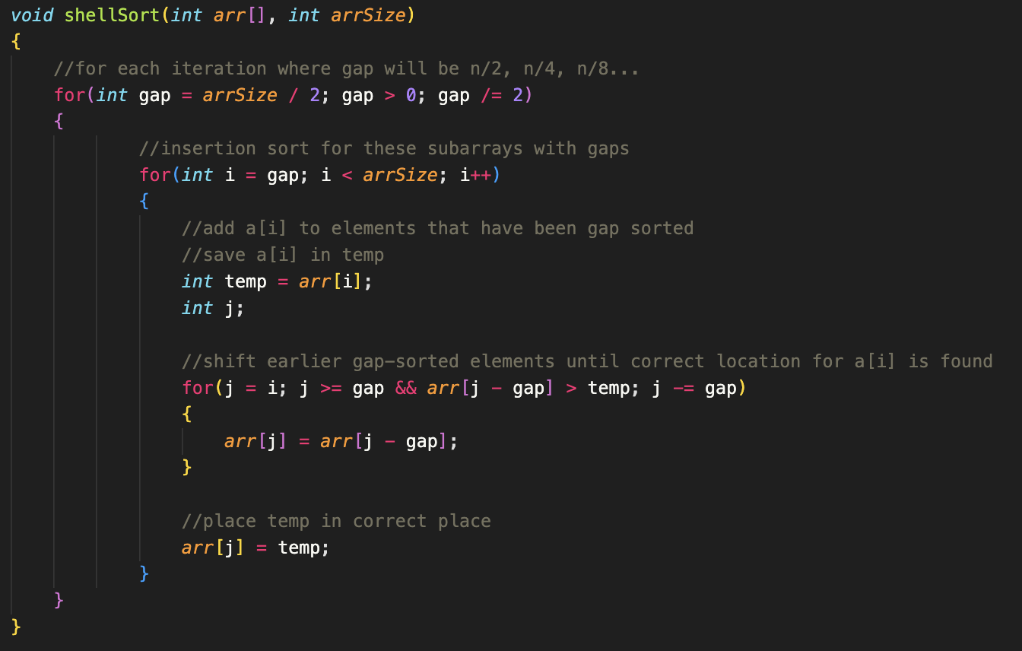
Shell Sort Implementation

Slide 9
Shell Sort Tracing
Let’s say we have an array with elements: 9, 8, 3, 7, 5, 6, 4, 1, 2
Trace the Shell Sort algorithm on this array!
Again, assume gap size to be equal to SizeOfArray / 2 and iterate until gap size is equal to 1

Slide 10
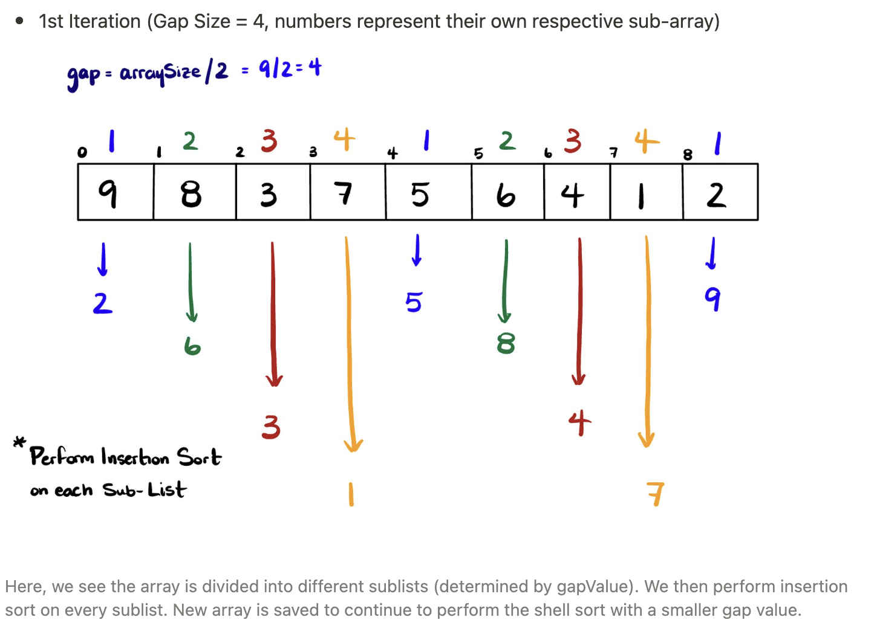

Slide 11
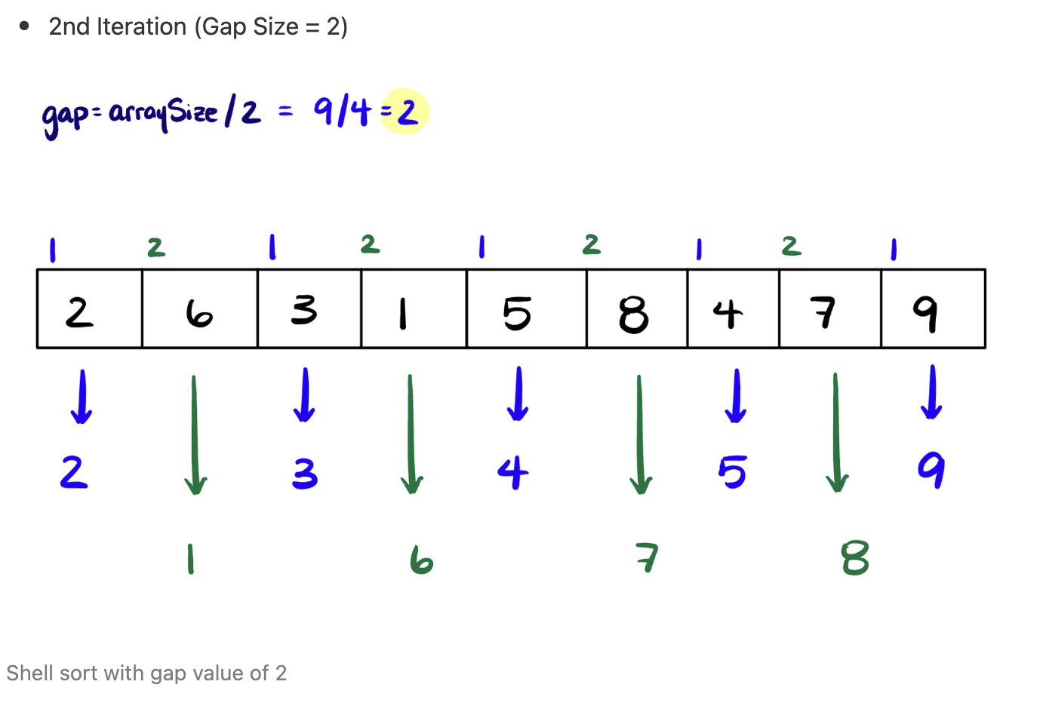

Slide 12
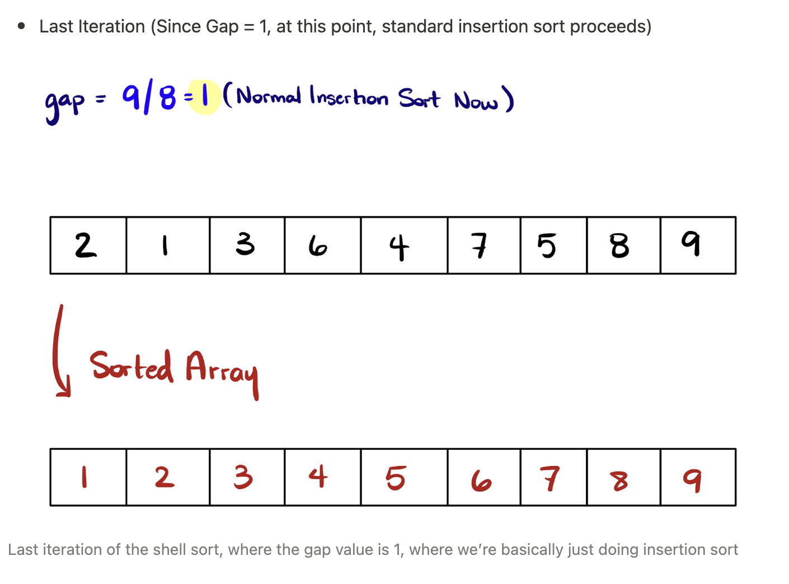

Slide 13
Heap Sort

Slide 14
Heaps & Binary Trees
It’s important to understand what trees and heaps are before we continue with the Heap sort algorithm.

Slide 15
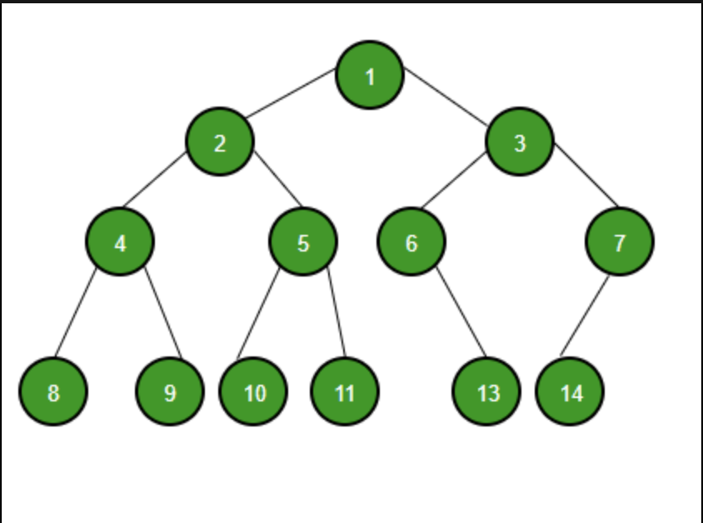
Binary Trees
A binary tree is a tree data structure in which each node can have at most two children, which are referred to as the left child and the right child.
Each node contains the following:
Data Item
Pointer to Left Child
Pointer to Right Child

Slide 16
Heaps
Heaps are a special tree-shaped data structure in which the tree is considered complete (a binary tree in which all the levels are completely filled except possibly the lowest one, which is filled from the left).
It as well must satisfy the heap property:
Max Heap: any given node is always greater than its child node/s and the key of the root node is the largest among all other nodes
Min Heap: any given node is always smaller than its child node/s and the key of the root node is the smallest among all other nodes

Slide 17
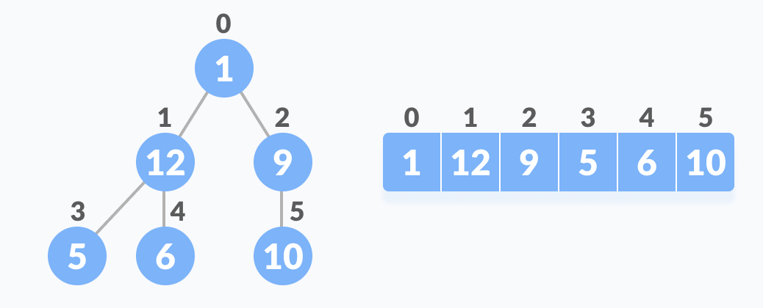
Relationship Between Array Indexes and Tree Elements
A complete binary tree has an interesting property that we can use to find the children and parents of any node.
If the index of any element in the array is i:
Parent Node Index → (i - 1) / 2
Left Child Index → 2i + 1
Right Child Index → 2i + 2

Slide 18
Heap Sort
In Heap sort, we visualize the elements of the given array as a binary tree, which is called a heap.
General Idea of Heap Sort:
Build a max/min heap from input (array)
Max/min value should now be at root node. Replace it with last item in heap and reduce heap size by 1. Then “heapify” root of tree.
Repeat (2) while size of heap is greater than 1

Slide 19

Heap Sort Video

Slide 20
Heap Sort Tracing
Let’s say we have an array with elements: 4, 8, 9, 10, 7, 1, 5, 12, 3, 6​
Trace using the Heap Sort algorithm!

Slide 21
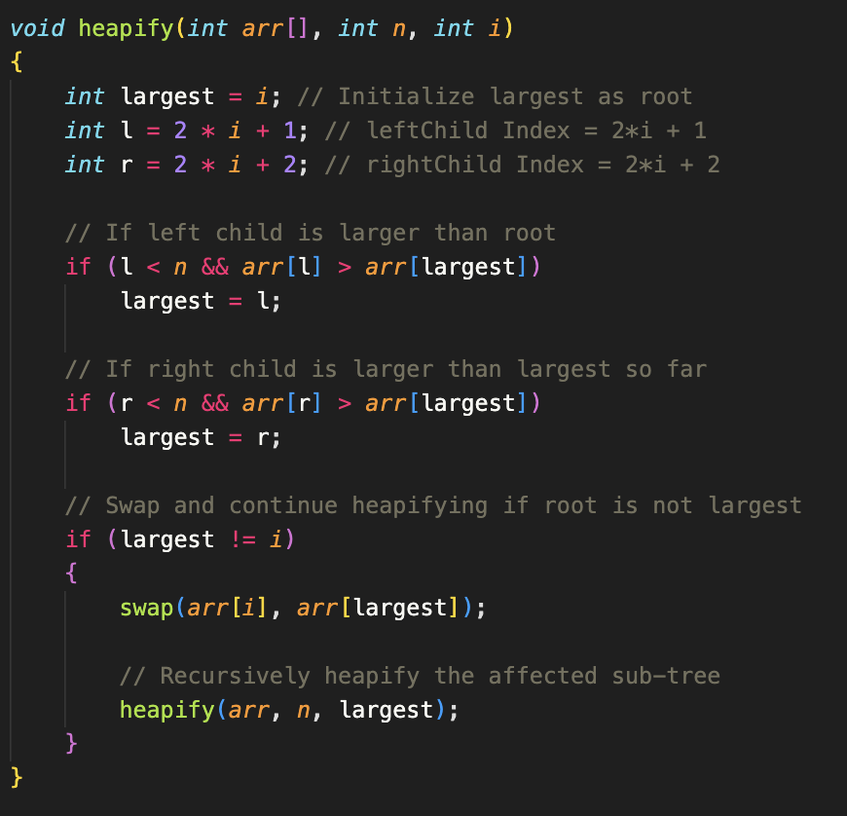
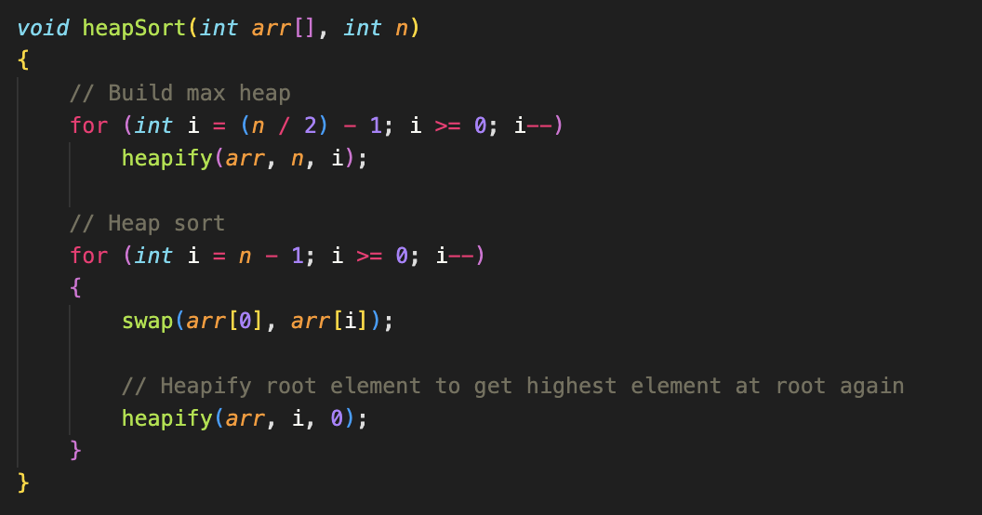
Heap Sort Implementation
heapify() is responsible for maintaining the max-heap property
heapSort() constructs the max heap and repeatedly extracts the maximum element to sort the array

Slide 22
Round Robin (Queues)

Slide 23
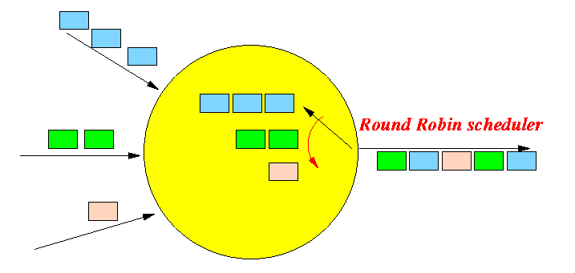
Round Robin
Round Robin is a scheduling algorithm that handle each processes according to the allocated quantum time and resources available during the current state of the machine.
Scheduling are commonly accessed and resolved in FIRST COME FIRST SERVE.
Gives each process a chance to run to execute from the available resources.
If the Process has remaining functions to be executed after available resource we move it to the back of the queue.
Round Robin ensures that each process will get to execute regardless of it’s priority. (Prevents starvation)

Slide 24
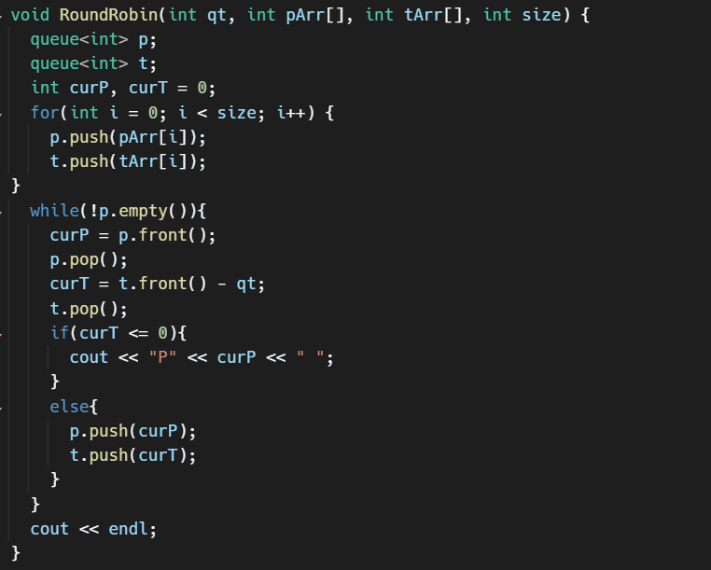
Code Implementation

Slide 25
Mid-Semester Workshop Survey
You all should have received a mid-semester survey to fill out. I encourage you all to fill it out.
Please take the next 5-10 minutes to fill this out.

